Slide 1

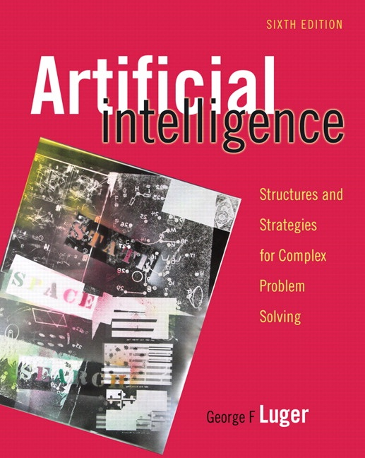
Machine Learning: Probabilistic
13.0 Stochastic and dynamic Models of Learning
13.1 Hidden Markov Models (HMMs)
13.2 Dynamic Bayesian Networks and Learning
13.3 Stochastic Extensions to Reinforcement Learning
13.4 Epilogue and References
13.5 Exercises
George F Luger
ARTIFICIAL INTELLIGENCE 6th edition
Structures and Strategies for Complex Problem Solving
Luger: Artificial Intelligence, 6th edition. © Pearson Education Limited, 2009
1

Slide 2
D E F I N I T I O N
HIDDEN MARKOV MODEL
A graphical model is called a hidden Markov model (HMM) if it is a Markov model whose states are not directly observable but are hidden by a further stochastic system interpreting their output. More formally, given a set of states S = s₁, s₂, ..., s_{n}, and given a set of state transition probabilities A = a₁₁, a₁₂, ..., a_{1n}, a₂₁, a₂₂, ..., ..., a_{nn}, there is a set of observation likelihoods, O = p_{i}(o_{t}), each expressing the probability of an observation o_{t} (at time t) being generated by a state s_{t}.
Luger: Artificial Intelligence, 6th edition. © Pearson Education Limited, 2009 2

Slide 3
Luger: Artificial Intelligence, 6th edition. © Pearson Education Limited, 2009 3

Slide 4
Luger: Artificial Intelligence, 6th edition. © Pearson Education Limited, 2009 4

Slide 5
Luger: Artificial Intelligence, 6th edition. © Pearson Education Limited, 2009 5

Slide 6
Luger: Artificial Intelligence, 6th edition. © Pearson Education Limited, 2009 6

Slide 7
Luger: Artificial Intelligence, 6th edition. © Pearson Education Limited, 2009 7

Slide 8
Luger: Artificial Intelligence, 6th edition. © Pearson Education Limited, 2009 8

Slide 9
Luger: Artificial Intelligence, 6th edition. © Pearson Education Limited, 2009 9

Slide 10
Start = 1.0 # n iy # end
neat
.00013
2 paths 1.0 1.0 x .00013 = .00013 .00013 x 1.0 = .00013 .00013 x .52 = .000067
need
.00056
2 paths 1.0 1.0 x .00056 = .00056 .00056 x 1.0 = .00056 .00056 x .11 = .000062
new
.001
2 paths 1.0 1.0 x .001 = .001 .001 x .36 = .00036 .00036 x 1.0 = .00036
knee
.000024
1 path 1.0 1.0 x .000024 = .000024 .000024 x 1.0 = .000024 .000024 x 1.0 = .000024
Total best .00036
Figure 13.8 A trace of the Viterbi algorithm on several of the paths of Figure 13.7. Rows
report the maximum value for Viterbi on each word for each input value (top row).
Adapted from Jurafsky and Martin (2008).
Luger: Artificial Intelligence, 6th edition. © Pearson Education Limited, 2009 10

Slide 11
function Viterbi(Observations of length T, Probabilistic FSM)
begin
number := number of states in FSM
create probability matrix viterbi[R = N + 2, C = T + 2];
viterbi[0, 0] := 1.0;
for each time step (observation) t from 0 to T do
for each state si from i = 0 to number do
for each transition from si to sj in the Probabilistic FSM do
begin
new-count := viterbi[si, t] x path[si, sj] x p(sj | si);
if ((viterbi[sj, t + 1] = 0) or (new-count > viterbi[sj, t + 1]))
then
begin
viterbi[si, t + 1] := new-count
append back-pointer [sj , t + 1] to back-pointer list
end
end;
return viterbi[R, C];
return back-pointer list
end.
Luger: Artificial Intelligence, 6th edition. © Pearson Education Limited, 2009 11

Slide 12
Luger: Artificial Intelligence, 6th edition. © Pearson Education Limited, 2009 12

Slide 13
Luger: Artificial Intelligence, 6th edition. © Pearson Education Limited, 2009 13

Slide 14
Luger: Artificial Intelligence, 6th edition. © Pearson Education Limited, 2009 14

Slide 15
Luger: Artificial Intelligence, 6th edition. © Pearson Education Limited, 2009 15

Slide 16
D E F I N I T I O N
A MARKOV DECISION PROCESS, or MDP
A Markov Decision Process is a tuple <S, A, P, R> where:
S is a set of states, and
A is a set of actions.
pa(st , st+1) = p(st+1 | st , at = a) is the probability that if the agent executes
action a Œ A from state st at time t, it results in state st+1 at time t+1. Since
the probability, pa Œ P is defined over the entire state-space of actions, it is
often represented with a transition matrix.
R(s) is the reward received by the agent when in state s.
Luger: Artificial Intelligence, 6th edition. © Pearson Education Limited, 2009 16

Slide 17
D E F I N I T I O N
A PARTIALLY OBSERVABLE MARKOV DECISION PROCESS, or POMDP
A Partially Observable Markov Decision Process is a tuple <S, A, O, P, R> where:
S is a set of states, and
A is a set of actions.
O is the set of observations denoting what the agent can see about its world.
Since the agent cannot directly observe its current state, the observations are
probabilistically related to the underlying actual state of the world.
pa(st, o, st+1) = p(st+1 , ot = o | st , at = a) is the probability that when the agent
executes action a from state st at time t, it results in an observation o that
leads to an underlying state st +1 at time t+1.
R(st, a, st+1) is the reward received by the agent when it executes action a in
state st and transitions to state st+1.
Luger: Artificial Intelligence, 6th edition. © Pearson Education Limited, 2009 17

Slide 18
Luger: Artificial Intelligence, 6th edition. © Pearson Education Limited, 2009 18

Slide 19
Luger: Artificial Intelligence, 6th edition. © Pearson Education Limited, 2009 19

